Slide 1
Tracking fires worldwide
January 23th
Juliana Aguilar
Lucía Delgado
Jorge Quintero

Slide 2
Objective
Provide a geographical visualization of fires around the world and contrast them with spatial data of human settlements
Daily updates
Useful to enhance resource allocation, particularly in organizations providing assistance to vulnerable populations
Extensions include tracking forest fires, land-clearing fires, and others

Slide 3
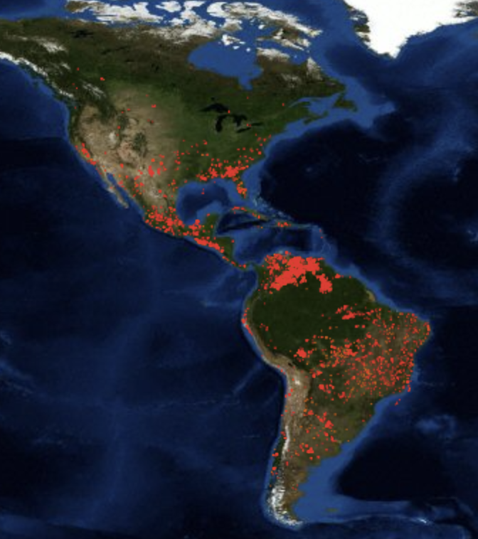
Data: Thermal anomalies
MODIS (Moderate Resolution Imaging Spectroradiometer)
The thermal anomalies are represented by the center of a 1km pixel that is flagged as containing one or more fires within the pixel
Updated daily
Source: https://earthdata.nasa.gov

Slide 4
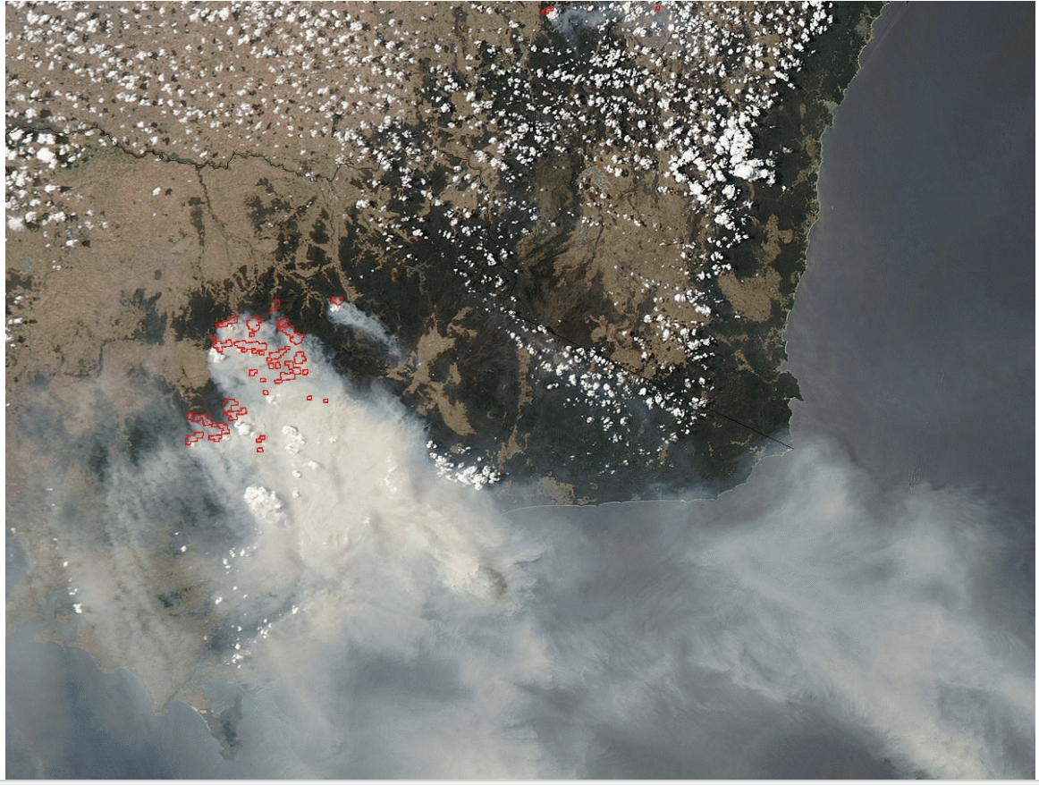
Data: Thermal anomalies
VIIRS (Visible Infrared Imaging Radiometer Suite)
Full global coverage every 12 hours from the VIIRS sensor aboard a NASA satellite. Updated daily
Provides a greater sensitivity to detect fires of relatively small areas
750 m spatial resolution
Source: https://earthdata.nasa.gov

Slide 5
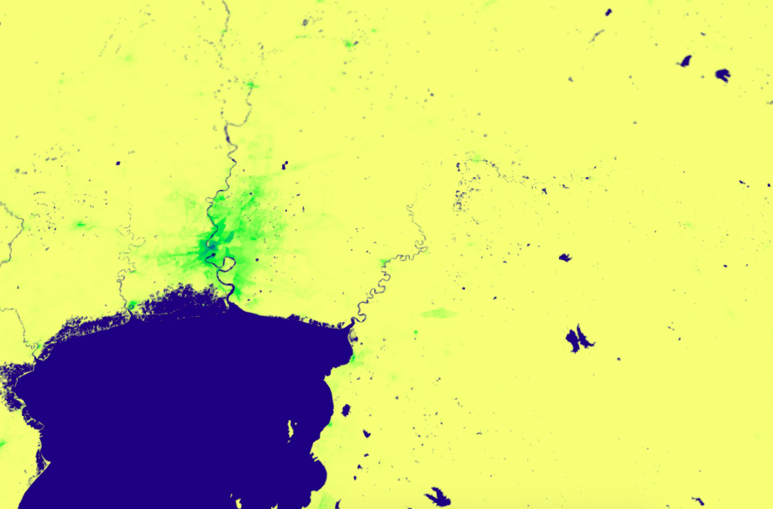
Data: High resolution population distribution maps
Worldpop
Estimates of the number of people living in each 100x100m in developing countries
Integrates census, survey, satellite and GIS data in a machine learning framework.
Source: http://www.worldpop.org.uk

Slide 6
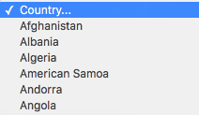
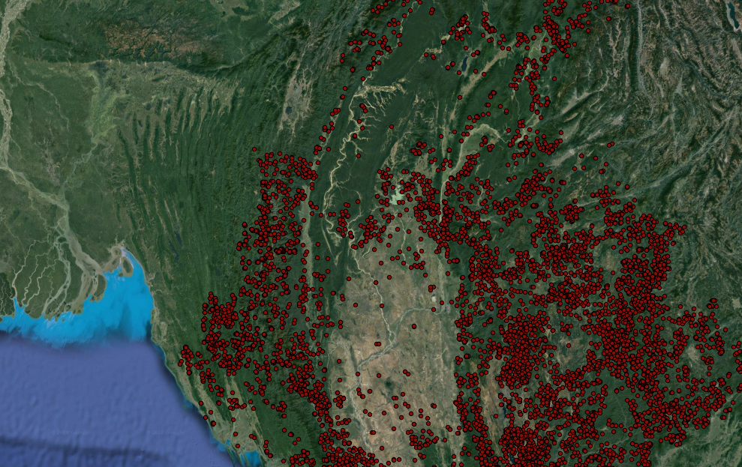
Expected Outcome
SELECT COUNTRY:
User friendly user platform that allows users to extract maps and data at the country level.
User will be able to obtain a map and download shapefiles for a specific country.

Slide 7
Steps:
Data collection
Merge archive data for fires with human settlement data. This code will be built in a way such that information on fires is easily updated.
Outcome: Map and a csv file.
Generate a code that performs Web scraping to extract thermo anomalies data from NASA’s webpage.
Outcome: Data in a format that is ready to be used by code made in step 2.
Generate interactive platform

Slide 8
Schedule
Activity | Week |  |  |  |  |  |  | Responsible
 | 3 | 4 | 5 | 6 | 7 | 8 | 9
I. Data Collection Thermal anomalies Population distribution |  |  |  |  |  |  |  | LD & JQ JA
II. Overlap maps |  |  |  |  |  |  |  | JA & LD
III. Web scraping: thermal anomalies |  |  |  |  |  |  |  | JQ
IV. User friendly platform |  |  |  |  |  |  |  | JA & LD

Slide 9
Libraries
GIS
Geopandas and Pyqgis (spatial data analysis)
Gdal and Fiona (for reading and writing different geospatial data formats)
Pyshp (for reading and writing shapefiles)
Pyproj (to convert between different projections of geospatial data)
Interactive Visualization
Geoplotlib
Bokeh
GeoViews
Plotly

